Slide 1
TETRIS GAME

Slide 2
Table of content
3Introduction ………………………………………………………………………………3
time slot …………………………………………………………………...………….4
class figure …………………………………………………………………...………….5
…………………………………………………………………...………….6
class Tetris …………………………………………………………………...………….7
…………………………………………………………………...………….8
…………………………………………………………………...………….9
…………………………………………………………………...………….10
…………………………………………………………………...………….11
…………………………………………………………………...………….12

Slide 3
Introduction
Tetris is a puzzle video game created by Soviet software engineer Alexey Pajitnov in 1984. It has been published by several companies for multiple platforms, after a significant period of publication by Nintendo, the rights reverted to Pajitnov in 1996, who co-founded the Tetris Company with Henk Rogers to manage licensing.
In Tetris, players complete lines by moving differently shaped pieces (tetrominoes), which descend onto the playing field. The completed lines disappear and grant the player points, and the player can proceed to fill the vacated spaces. The game ends when the playing field is filled. The longer the player can delay this outcome, the higher their score will be. We will be developing the Tetris game using advanced programming language importing PyGame and random libraries.

Slide 4

Time Slot
1st Event Project Proposal | 2nd Event The code | 3rd Event Presentation
Deadline: 15-3 | Deadline: 15-5 | Deadline: 17-5
Describing the idea of the project and the main point we are going to work on. | Working on the code | Presenting our work

Slide 5
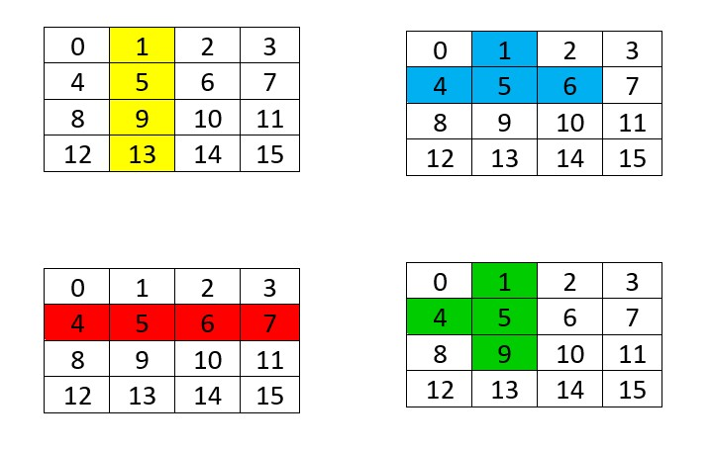
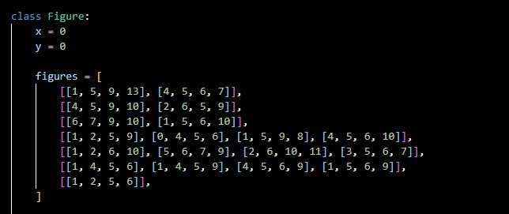
Class Figure
Where the main list contains figure types, and the inner lists contain their rotations. The numbers in each figure represent the positions in a 4x4 matrix where the figure is solid. For instance, the figure [1,5,9,13] represents a line.

Slide 6
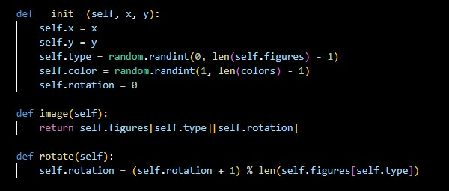
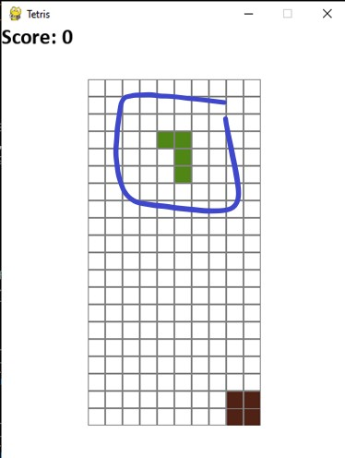
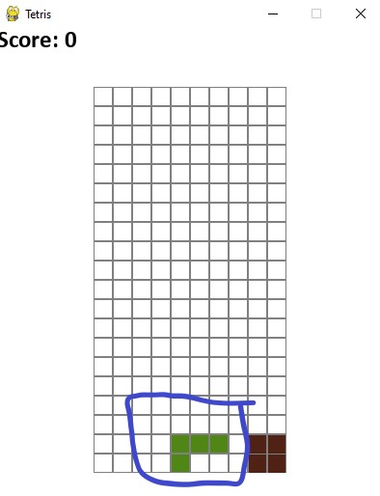
We randomly choose the shape and the color and must be able to rotate the shape.

Slide 7
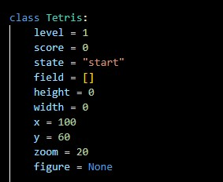
Class Tetris
This is the initialization of game variables

Slide 8
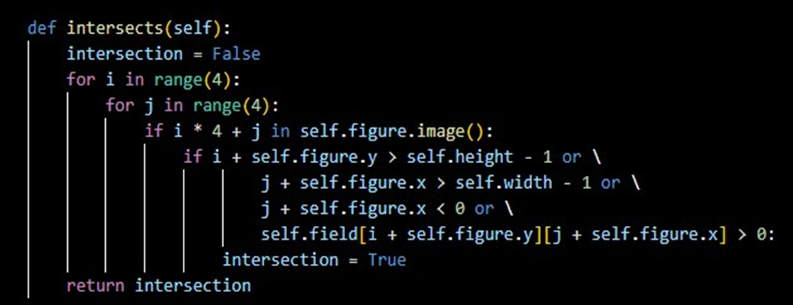
In this function, we are checking if the currently flying figure intersects with other fixed ones on the field. This may happen when the figure is moving left, right, down, or rotating.

Slide 9
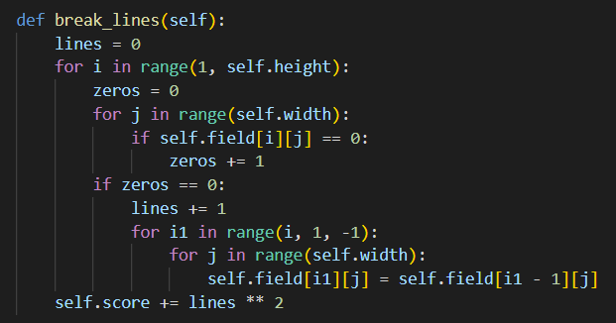
Checking the full lines is relatively simple and straightforward, however an interesting fact occurs, the destroying of a line goes from the bottom to the top.

Slide 10
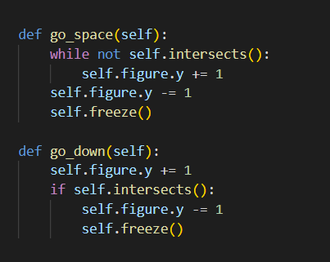
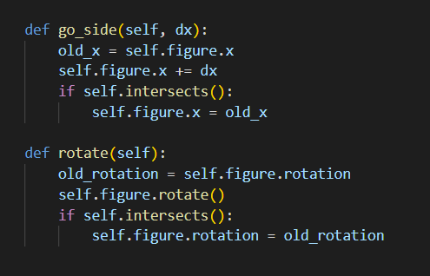
As you can see, the go space method appears practically identical to the go down method, except that it sinks until it hits the bottom or some preset figure.
And in each method, we remember previous point, update the coordinates, and check for collisions. If so, we return to the original state.

Slide 11
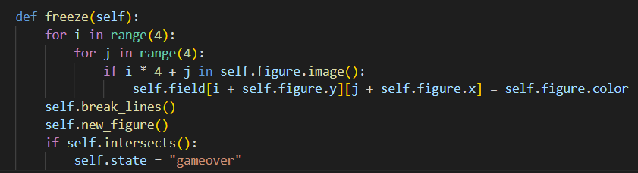
We can now use this function to determine whether we are permitted to move or rotate the Figure. If it slides down and connects, it implies we've reached the bottom, and we need to "freeze" the figure on our field. We need to see whether there are any whole horizontal lines that should be destroyed after freezing. Then we create a new Figure, and if it connects with the previous one, the game is over:)

Slide 12
Thanks For Attention!
Any questions?
Pay attention through the demo of the game, some interesting facts are hidden ^^.
Presented By:
Ballout Zaynab
Ezzdeen Mona
Presented To:
Dr. Komati Ali

